Slide 1



Slide 2
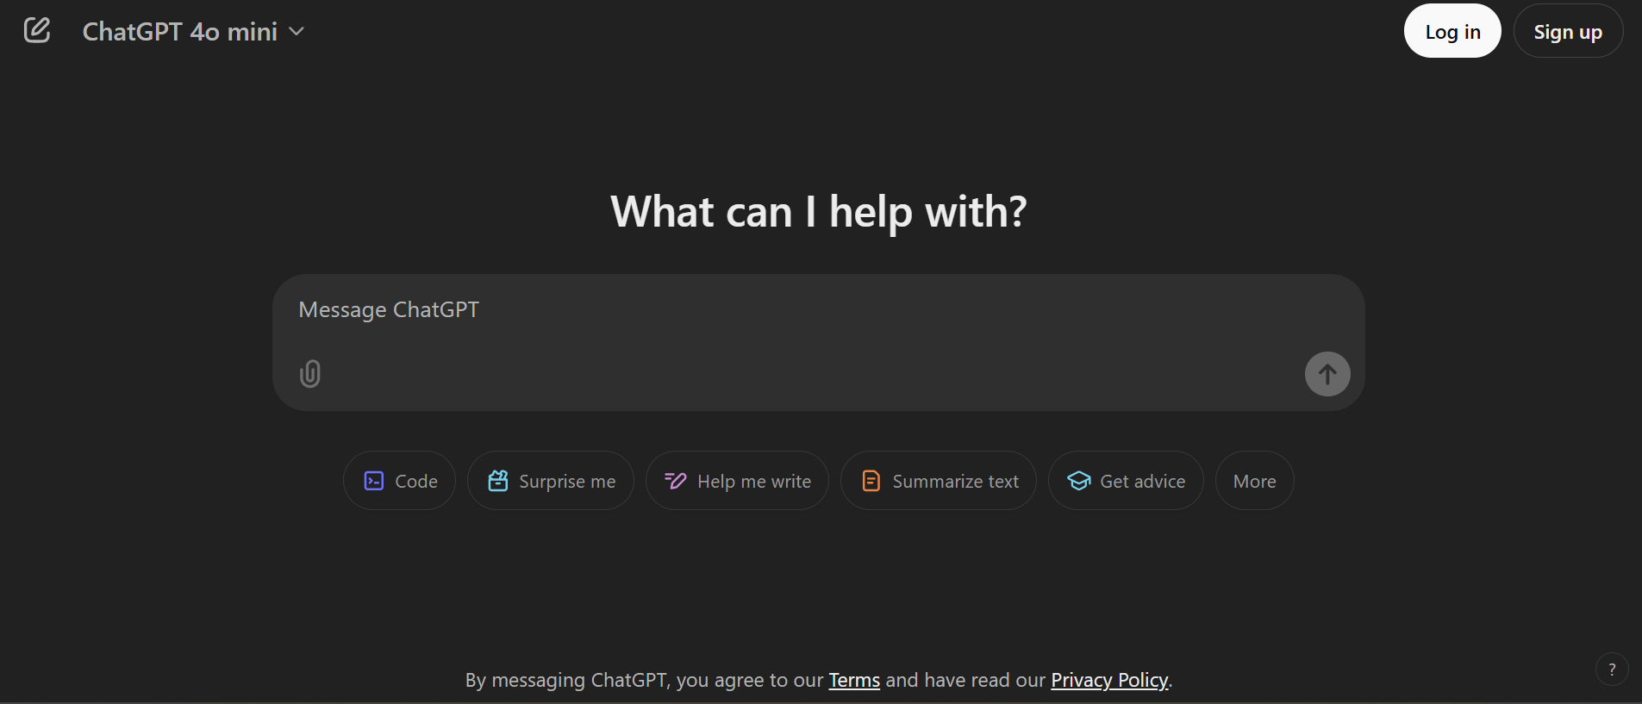
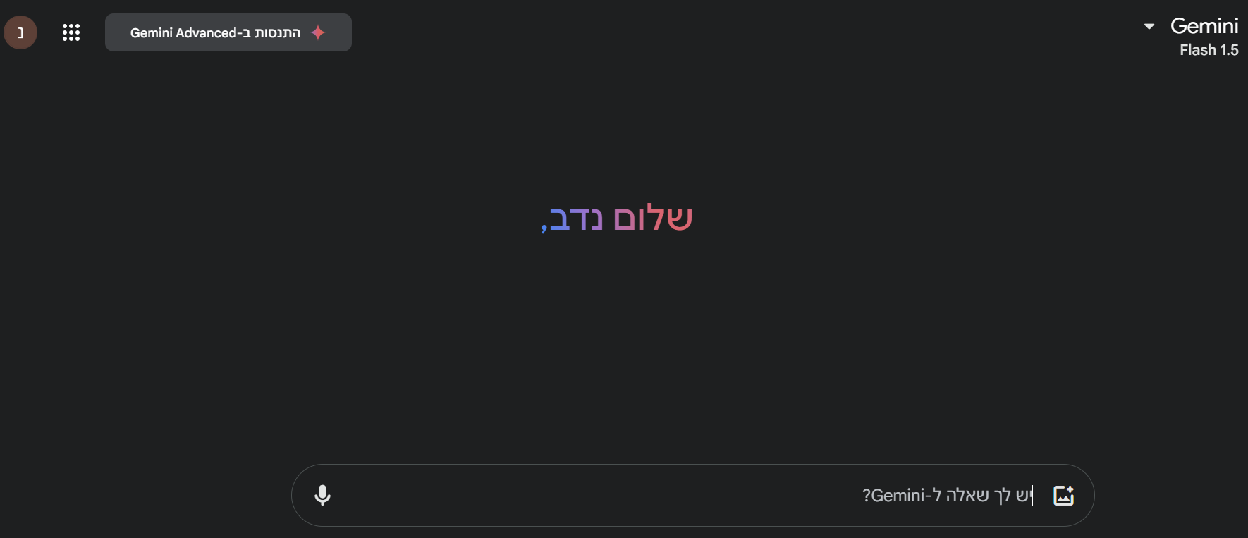
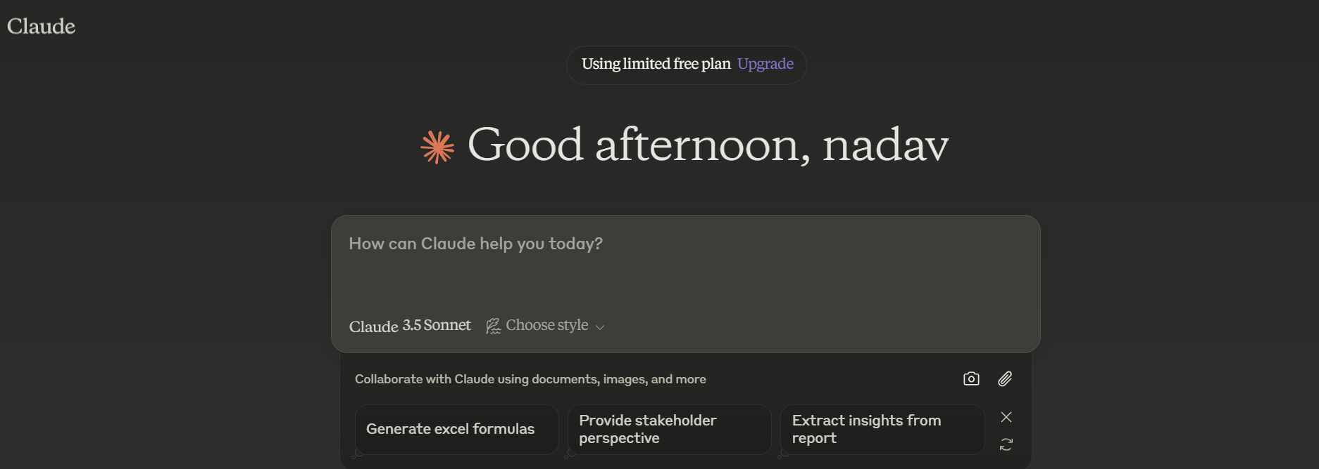
Anyone not using one of these models?

Slide 3
What are these models?
LLM – Large Leanguage Models
1) Large Language Models (LLM): LLMs are machine learning models focused on understanding and generating natural language text.
2) Architecture: Based on Transformer, a neural network technique that understands relationships between words.
3) Trained on Massive Datasets: Trained on large amounts of text data to learn patterns of grammar and meaning.
4) Versatile Applications: Translation, content creation, chatbots, text summarization, sentiment analysis.
5) Challenges: Ethical issues, contextual understanding problems, data biases.
6) The Future: Improving accuracy, integration with new technologies, and expanding applications.

Slide 4

Over the past few years LLM burst into our life in the past years impacting every human life . This research aims to help us understand the current state of LLM logic understanding and recent development related to this topic . Despite the huge lap LLM made in recent years we believe there is still room to improve especially in understanding human logic.

Slide 5
Research question:
Do LLM’s (Large Language Model) understand human logic? If so, at what level? Can LLM’s understanding of human logic be improved?

Slide 6
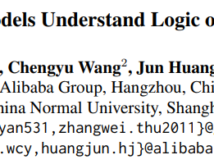
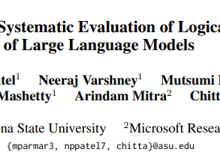
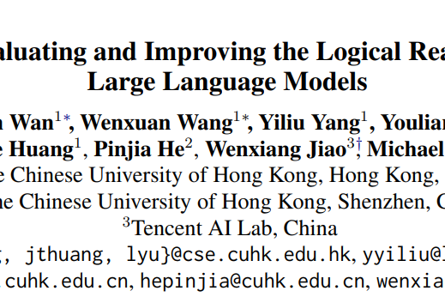
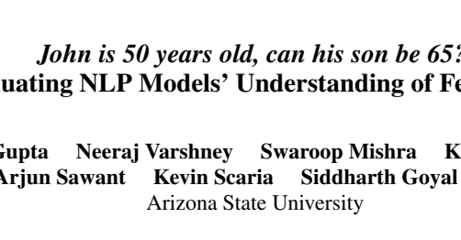
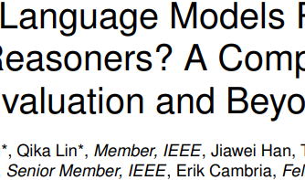
LITERATURE REVIEW –

Slide 7

LITERATURE REVIEW OVERVIEW
What is human logic?
The studies defines logic as crucial part of intelligence that helps us human get along with our environment
How does LLM try to solve logic questions?
Based on the studies we learned LLM mainly rely on pattern recognition and memorization (using a question that already been asked as a reference or using a data that he been trained on)
How to evaluate LLM?
The studies show that large models are evaluated using metrics like exact match accuracy and recall to assess their ability to identify correct answers and make logical inferences. LogicBench, for example, evaluates models' logical reasoning through tasks involving entailment and conclusion selection.
What can be done to improve LLM understanding of logic?
The studies mark few options most of them being retrain the model on new data sets.

Slide 8

Requirements document

Slide 9

Requirements document
requirements document
Data
We will use a data set ,a few hundred question templates that we will create, and a prompt data set ,prompts that we checked and can improve the LLM on certain aspects, and combine them in order to find the best prompt for each question type.
Data Input
We will also allow user to input their own question and answer and their own prompt to check our system .
LLM
We would choose models from the availability LLM’s that currently working and We will asses those model and choose the best according to our initial score assessment and try to improve it.
Logic
The research will test a few types of human logic - Propositional Logic and Non-monotonic Reasoning, we will test the logic in a few ways – binary classification questions, multiple-choice questions, and open-ended questions.

Slide 10
Requirements document
User experience
The user will be to choose an LLM, question type, and prompt, and the system will give the model a score based on its performance on the question. This way, the user will experience our study results through the app.
Output
By the end we expect to have the best model in each logical question category we examine, Also we expect to get the improvement (if we succeed) value for each model we test .
Score assessment and bias inspection
We will build a database with question templates and evaluate the model based on its ability to identify correct logical arguments and apply logical principles. To avoid bias, we will use multiple questions and compare to previous studies.
Overall Success Metric
The overall score averages the performance across all metrics, considering correctness, logic, clarity, and relevance for each question type.

Slide 11
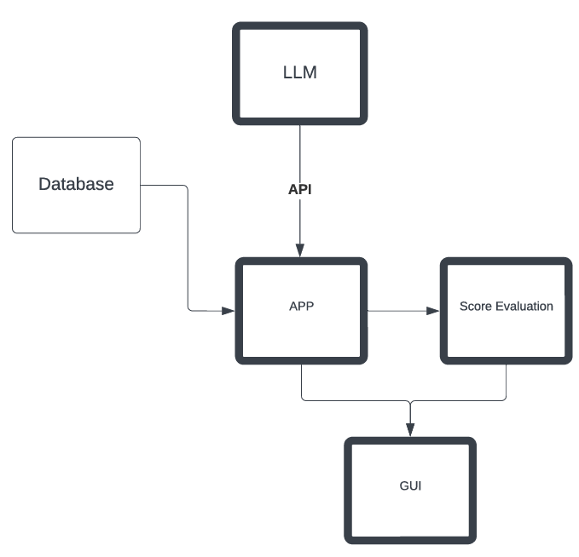

Slide 12
Development stages
Database phase
App phase
Test phase
Improvement phase
Conclusion phase

Slide 13

Thank you very much!

